Slide 1
Transmission
Control
Protocol (TCP)
TCP/IP Protocol Suite
1
Copyright © The McGraw-Hill Companies, Inc. Permission required for reproduction or display.

Slide 2
OBJECTIVES:
To introduce TCP as a protocol that provides reliable stream delivery service.
To define TCP features and compare them with UDP features.
To define the format of a TCP segment and its fields.
To show how TCP provides a connection-oriented service, and show the segments exchanged during connection establishment and connection termination phases.
To introduce windows in TCP that are used for flow and error control.
TCP/IP Protocol Suite
2

Slide 3
OBJECTIVES (continued):
To discuss how TCP implements flow control in which the receive window controls the size of the send window.
To discuss error control used by TCP during the data transmission phase.
To discuss how TCP controls the congestion in the network using different strategies.
To list and explain the purpose of each timer in TCP.
To discuss options in TCP and show how TCP can provide selective acknowledgment using the SACK option.
TCP/IP Protocol Suite
3

Slide 4
Chapter Outline
TCP Services
TCP Features
Segment
A TCP Connection
Windows in TCP
Flow Control
Error Control
Congestion Control
TCP Timers
Options
TCP Package
TCP/IP Protocol Suite
4

Slide 5
15-1 TCP SERVICES
Figure 15.1 shows the relationship of TCP to the other protocols in the TCP/IP protocol suite. TCP lies between the application layer and the network layer, and serves as the intermediary between the application programs and the network operations.
TCP/IP Protocol Suite
5

Slide 6
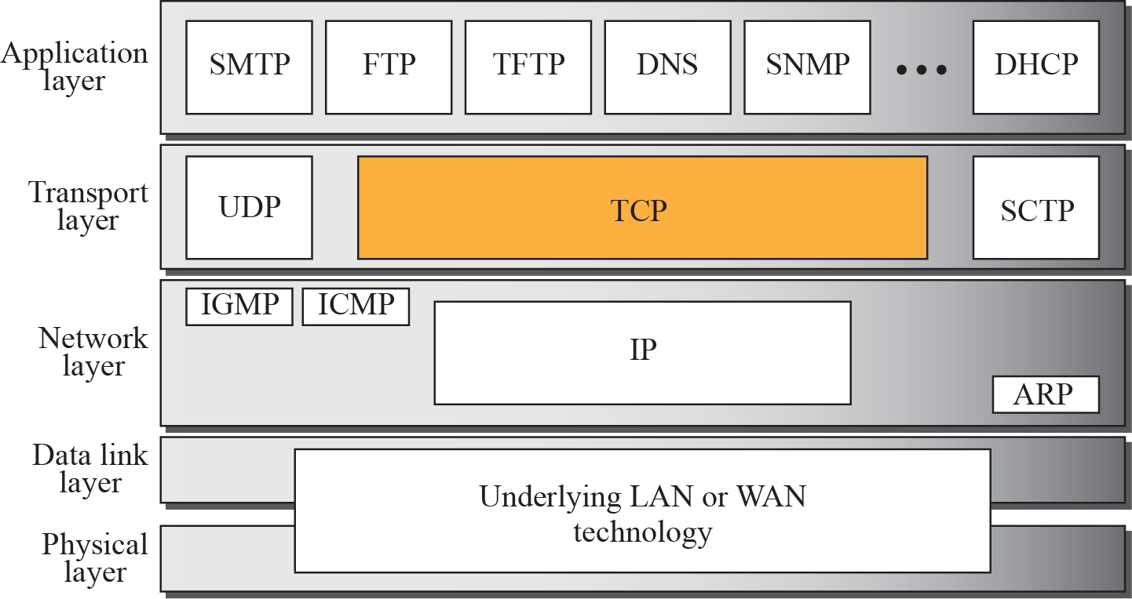
Figure 15.1 TCP/IP protocol suite
TCP/IP Protocol Suite
6

Slide 7
Topics Discussed in the Section
Process-to-Process Communication
Stream Delivery Service
Full-Duplex Communication
Multiplexing and Demultiplexing
Connection-Oriented Service
Reliable Service
TCP/IP Protocol Suite
7

Slide 8
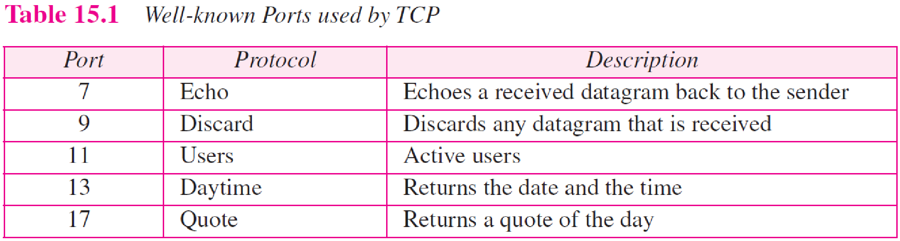
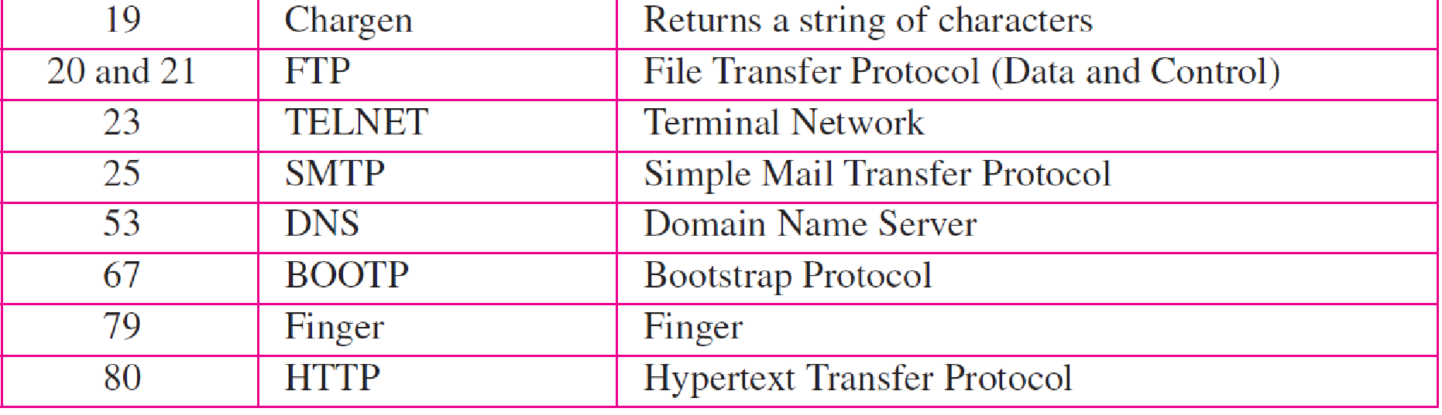
TCP/IP Protocol Suite
8

Slide 9
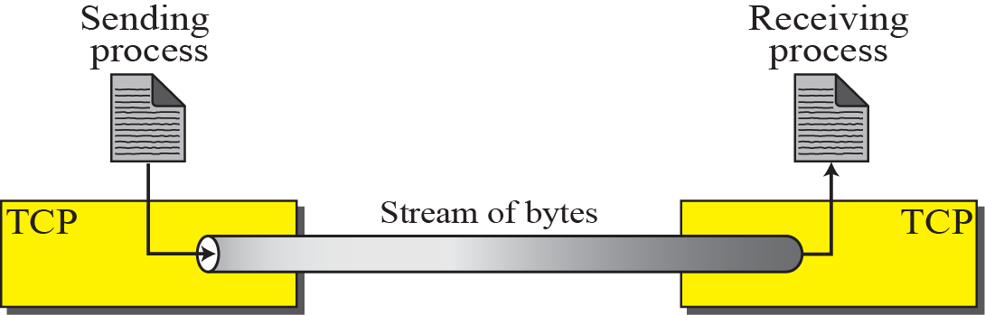
Figure 15.2 Stream delivery
TCP/IP Protocol Suite
9

Slide 10
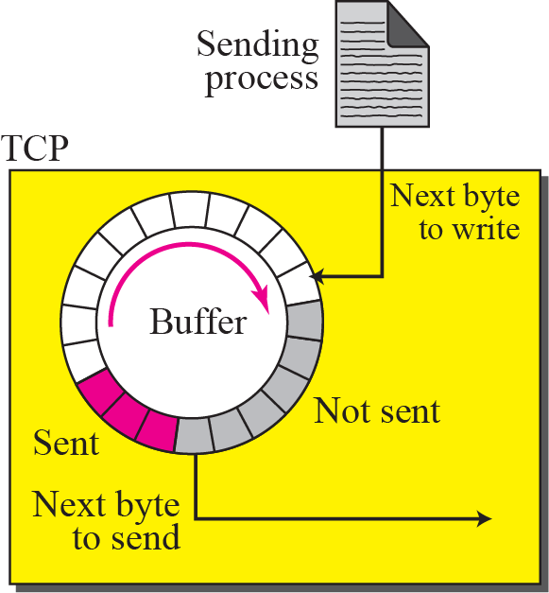
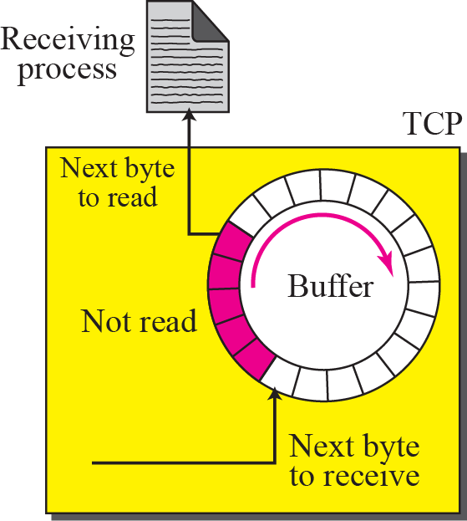
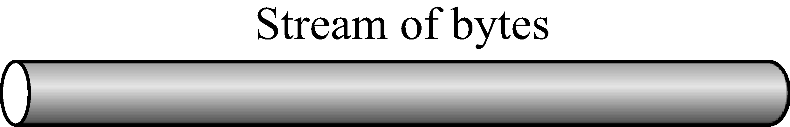
Figure 15.3 Sending and receiving buffers
TCP/IP Protocol Suite
10

Slide 11
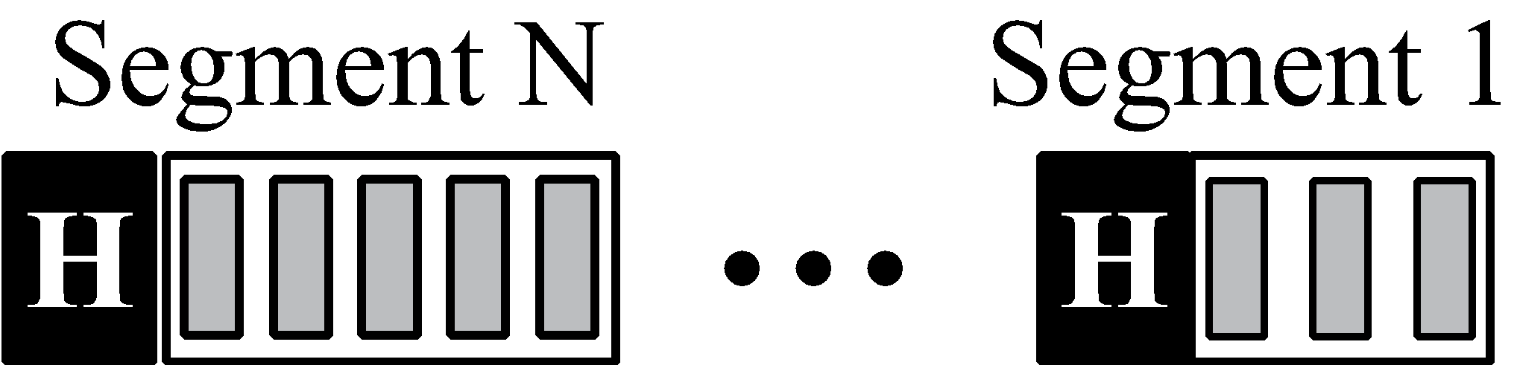
Figure 15.4 TCP segments
TCP/IP Protocol Suite
11

Slide 12
Full duplex communication
Multiplexing and demultiplexing
Connection oriented service
Reliable service: it uses ack mechanism to check the safe and sound arrival of data
TCP/IP Protocol Suite
12

Slide 13
15-2 TCP FEATURES
To provide the services mentioned in the previous section, TCP has several features that are briefly summarized in this section and discussed later in detail.
TCP/IP Protocol Suite
13

Slide 14
Topics Discussed in the Section
Numbering System
Flow Control
Error Control
Congestion Control
TCP/IP Protocol Suite
14

Slide 15
Numbering System
Although the TCP software keeps track of the segments being transmitted or received, there is no field for a segment number value in the segment header. Instead, there are two fields called the sequence number and the acknowledgment number. These two fields refer to a byte number and not a segment number.
TCP/IP Protocol Suite
15

Slide 16
Byte Number
TCP numbers all data bytes (octets) that are transmitted in a connection.
Numbering is independent in each direction. When TCP receives bytes of data from a process, TCP stores them in the sending buffer and numbers them.
The numbering does not necessarily start from 0. Instead, TCP chooses an arbitrary number between 0 and 2^32− 1 for the number of the first byte.
For example, if the number happens to be 1,057 and the total data to be sent is 6,000 bytes, the bytes are numbered from 1,057 to 7,056.
We will see that byte numbering is used for flow and error control

Slide 17

Note
The bytes of data being transferred in each connection are numbered by TCP.
The numbering starts with an arbitrarily generated number.
TCP/IP Protocol Suite
17

Slide 18
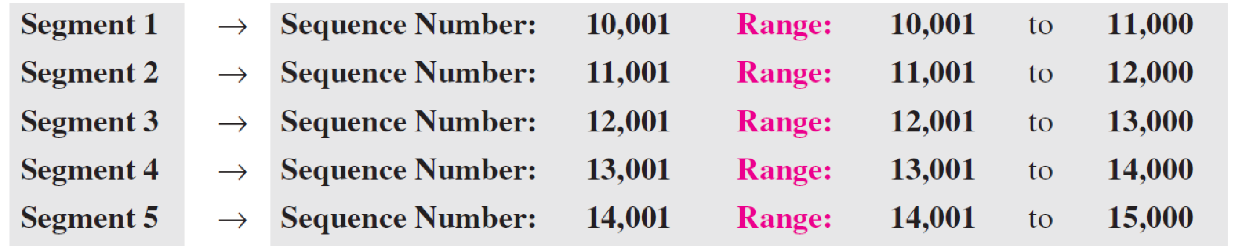
Example 15.1
Suppose a TCP connection is transferring a file of 5,000 bytes. The first byte is numbered 10,001. What are the sequence numbers for each segment if data are sent in five segments, each carrying 1,000 bytes?
Solution
The following shows the sequence number for each segment:
TCP/IP Protocol Suite
18

Slide 19
Note
The value in the sequence number field of a segment defines the number assigned to the first data byte contained in that segment.
Data byte 1
Data byte 2
Data byte 3
Data byte 4
Data byte 5
segment
TCP/IP Protocol Suite
19

Slide 20
Note
The value of the acknowledgment field in a segment defines the number of the next byte a party expects to receive.
The acknowledgment number is cumulative.
TCP/IP Protocol Suite
20

Slide 21
15-3 SEGMENT
Before discussing TCP in more detail, let us discuss the TCP packets themselves. A packet in TCP is called a segment.
TCP/IP Protocol Suite
21

Slide 22
Topics Discussed in the Section
Format
Encapsulation
TCP/IP Protocol Suite
22

Slide 23
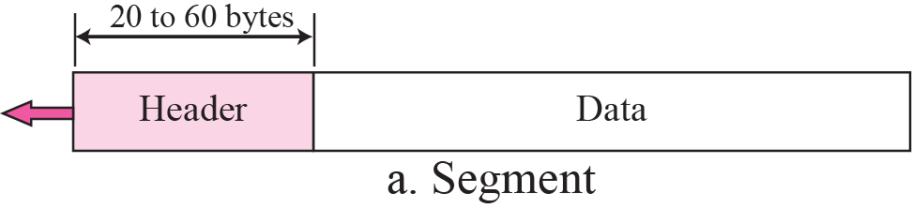
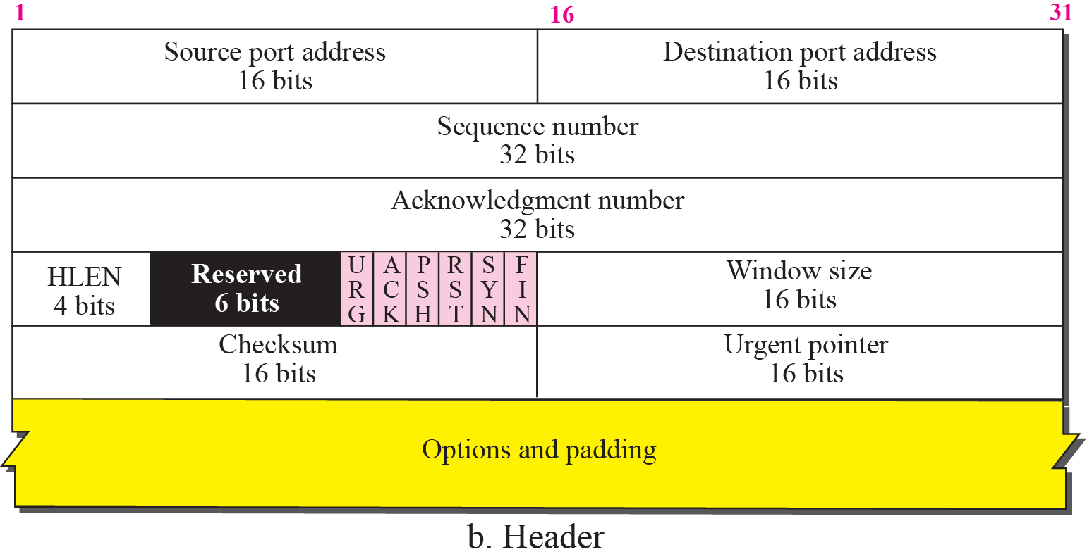
Figure 15.5 TCP segment format
TCP/IP Protocol Suite
23

Slide 24
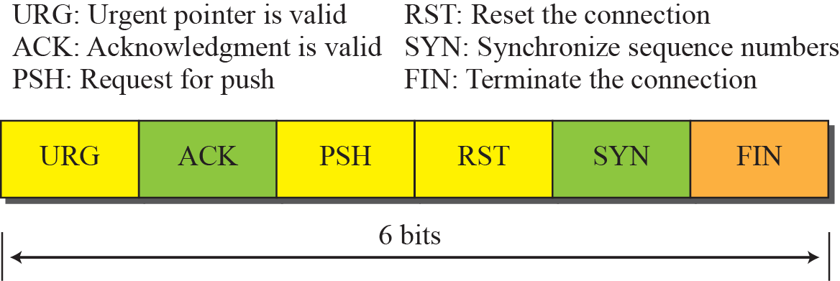
Figure 15.6 Control field
TCP/IP Protocol Suite
24

Slide 25
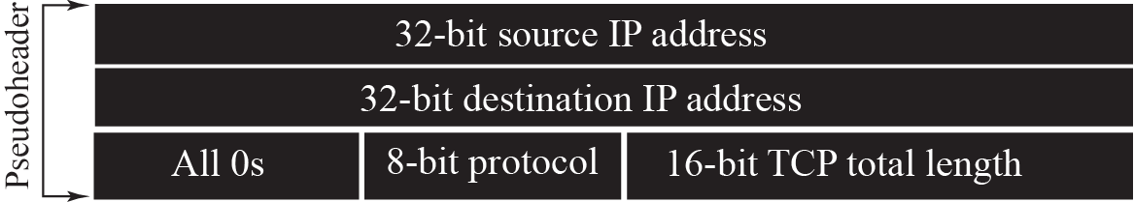
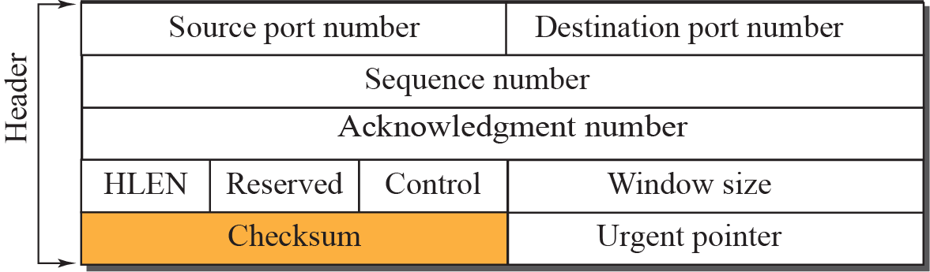

Figure 15.7 Pseudoheader added to the TCP segment
TCP/IP Protocol Suite
25

Slide 26
Note
The use of the checksum in TCP is mandatory.
TCP/IP Protocol Suite
26

Slide 27

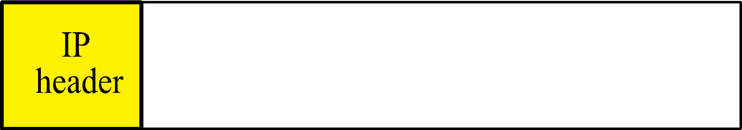

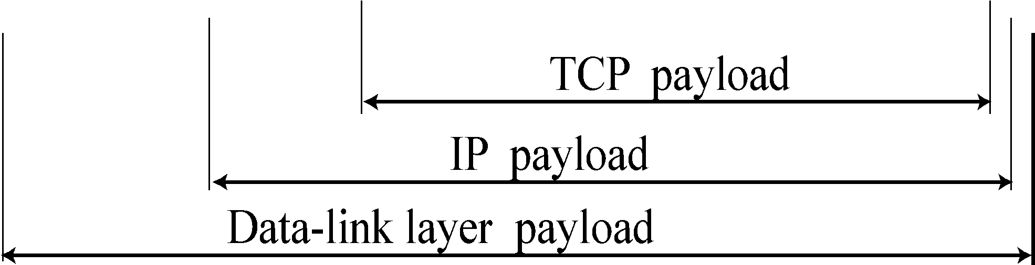
Figure 15.8 Encapsulation
TCP/IP Protocol Suite
27

Slide 28
15-4 A TCP CONNECTION
TCP is connection-oriented.
It establishes a virtual path between the source and destination.
All of the segments belonging to a message are then sent over this virtual path.
You may wonder how TCP, which uses the services of IP, a connectionless protocol, can be connection-oriented. The point is that a TCP connection is virtual, not physical. TCP operates at a higher level.
TCP uses the services of IP to deliver individual segments to the receiver, but it controls the connection itself. If a segment is lost or corrupted, it is retransmitted.
TCP/IP Protocol Suite
28

Slide 29
Topics Discussed in the Section
Connection Establishment
Data Transfer
Connection Termination
Connection Reset: RST FLAG
TCP/IP Protocol Suite
29

Slide 30
three-way handshake
A three-way handshake is a method used in a TCP/IP network to create a connection between a local host/client and server. It is a three-step method that requires both the client and server to exchange SYN and ACK (acknowledgment) packets before actual data communication begins.
A three-way handshake is also known as a TCP handshake.
30

Slide 31
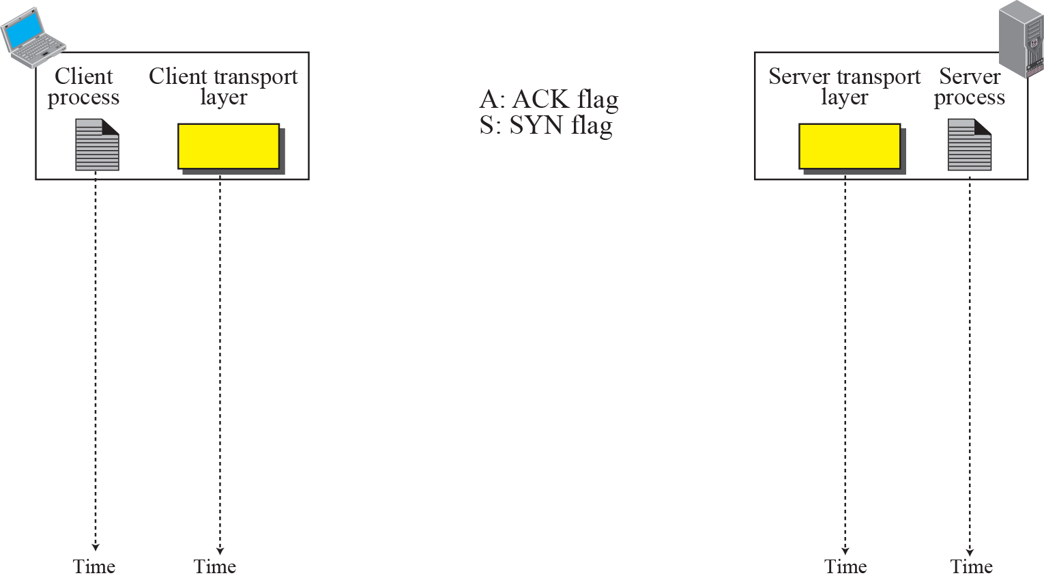


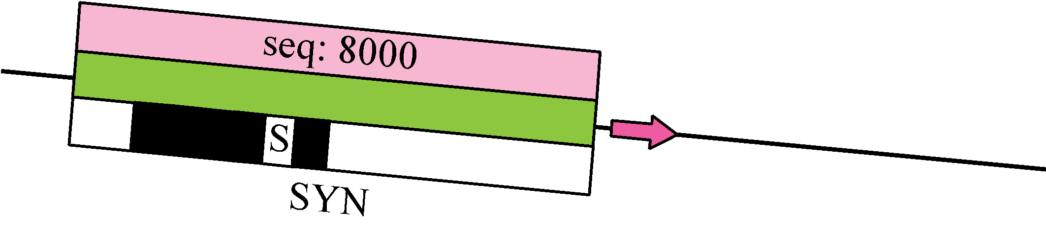
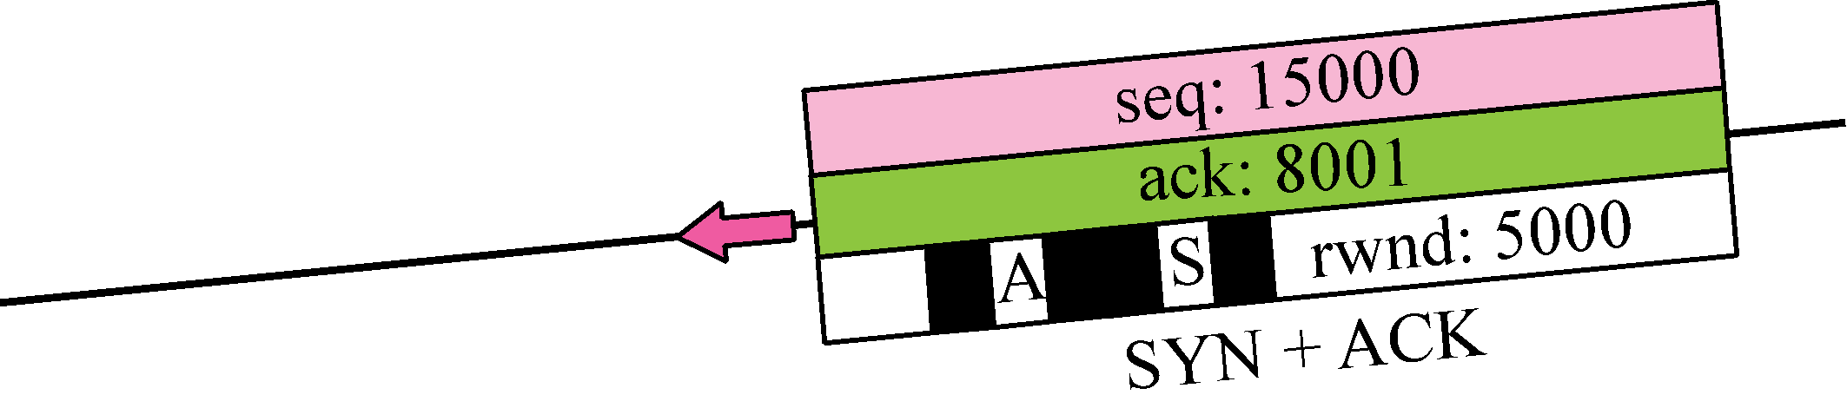
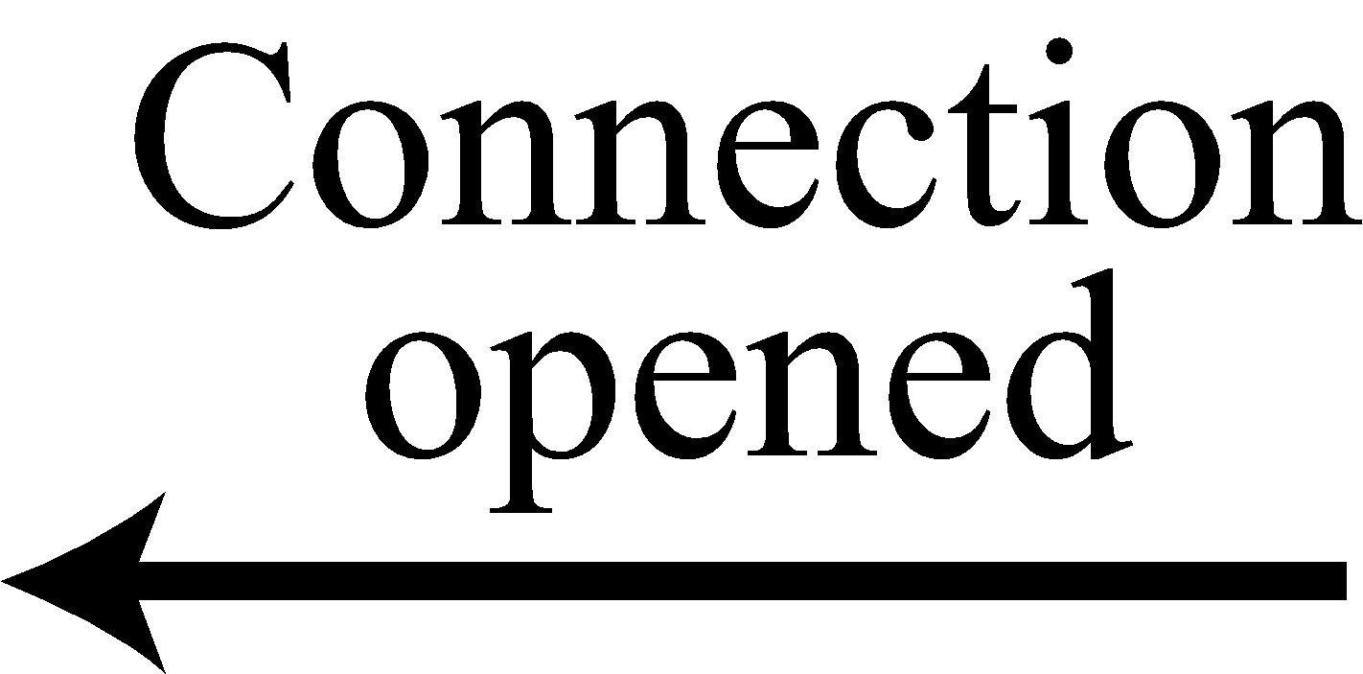
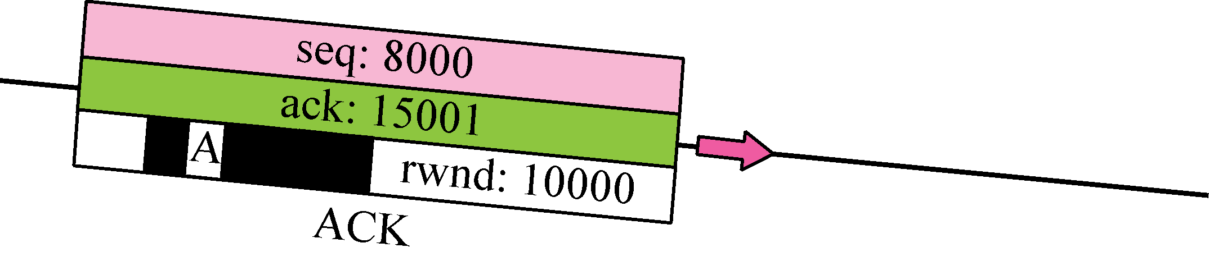
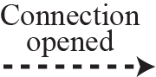
Figure 15.9 Connection establishment using three-way handshake
TCP/IP Protocol Suite
31

Slide 32
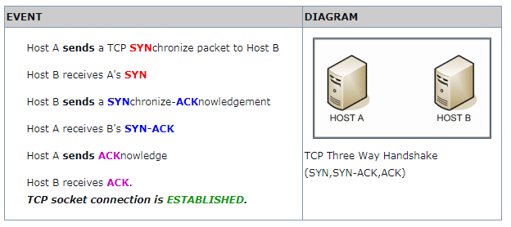
TCP/IP Protocol Suite
32

Slide 33
A client node sends a SYN data packet over an IP network to a server on the same or an external network. The objective of this packet is to ask/infer if the server is open for new connections.
The target server must have open ports that can accept and initiate new connections. When the server receives the SYN packet from the client node, it responds and returns a confirmation receipt – the ACK packet or SYN/ACK packet.
The client node receives the SYN/ACK from the server and responds with an ACK packet.
Upon completion of this process, the connection is created and the host and server can communicate.
TCP/IP Protocol Suite
33

Slide 34
Note
A SYN segment cannot carry data, but it consumes one sequence number.
TCP/IP Protocol Suite
34

Slide 35
Note
A SYN + ACK segment cannot carry data, but does consume one sequence number.
TCP/IP Protocol Suite
35

Slide 36
Note
An ACK segment, if carrying no data, consumes no sequence number.
TCP/IP Protocol Suite
36

Slide 37
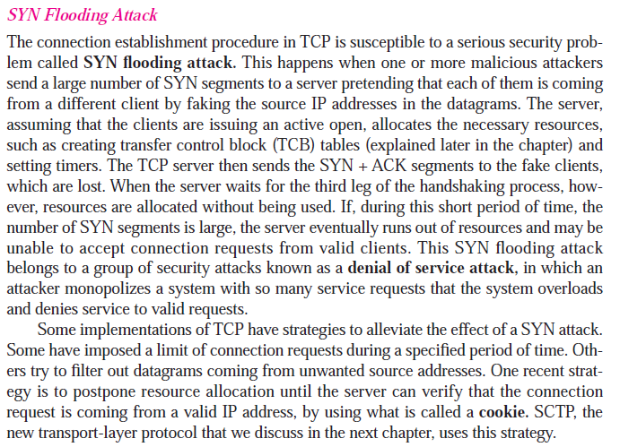

Slide 38
client 1
syn
server
syn+ ack
syn
client 2
syn+ ack
syn
client 3
syn+ ack
syn
client n
syn+ ack

Slide 39
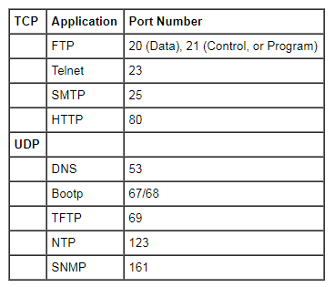
TCP/IP Protocol Suite
39

Slide 40
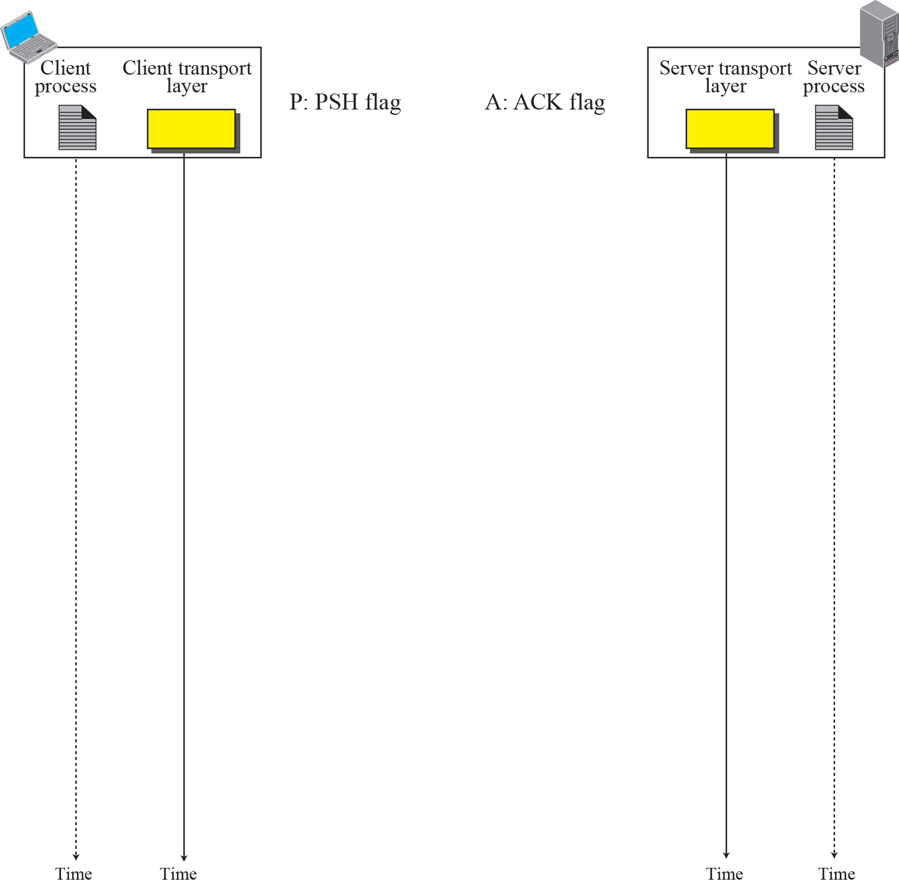
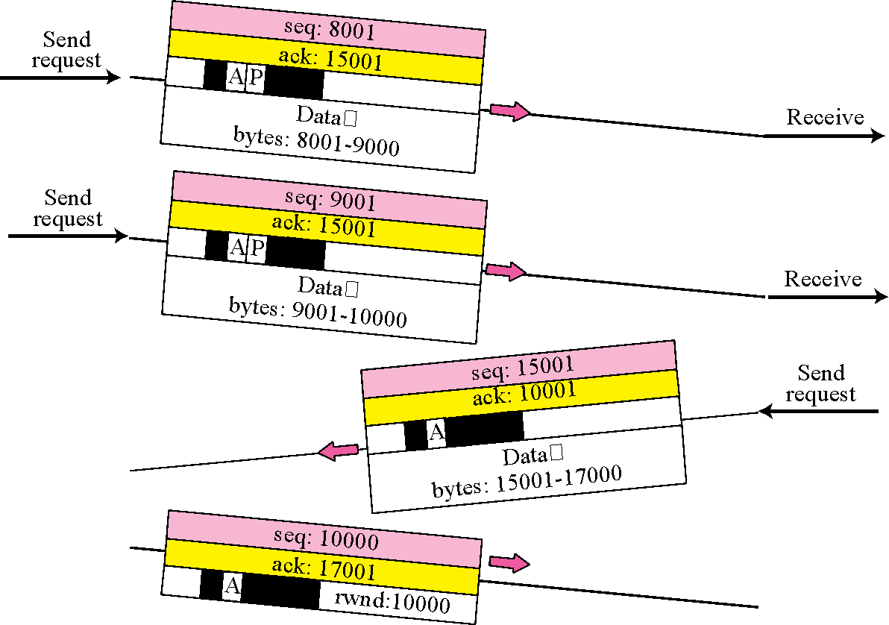
Figure 15.10 Data Transfer
Connection establishment
Connection termination
TCP/IP Protocol Suite
40

Slide 41
Figure 15.11 Connection termination using three-way handshake
2 options for termination:
3 way handshaking
Four way handshaking with a half close option
TCP/IP Protocol Suite
41

Slide 42
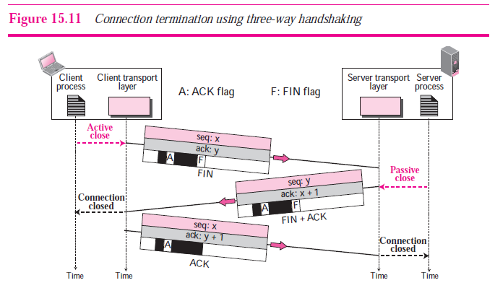
TCP/IP Protocol Suite
42

Slide 43
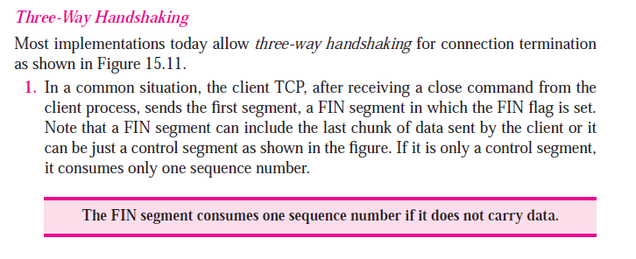
TCP/IP Protocol Suite
43

Slide 44
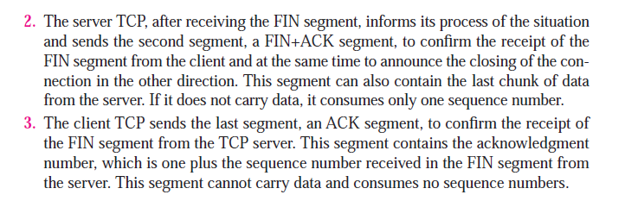
TCP/IP Protocol Suite
44

Slide 45
Note
The FIN segment consumes one sequence number if it does not carry data.
TCP/IP Protocol Suite
45

Slide 46
Note
The FIN + ACK segment consumes one sequence number if it does not carry data.
TCP/IP Protocol Suite
46

Slide 47
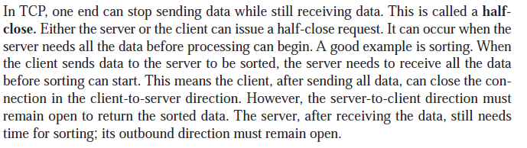
Figure 15.12 Half-Close
TCP/IP Protocol Suite
47

Slide 48
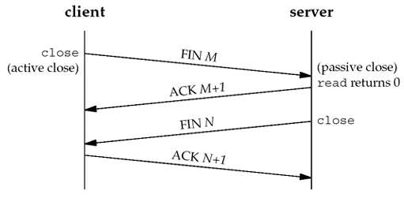
TCP/IP Protocol Suite
48

Slide 49
Connection reset
Denying a connection
Aborting a connection
Termination an idle connection
TCP/IP Protocol Suite
49

Slide 50
15-6 WINDOWS IN TCP
Before discussing data transfer in TCP and the issues such as flow, error, and congestion control, we describe the windows used in TCP. TCP uses two windows (send window and receive window) for each direction of data transfer, which means four windows for a bidirectional communication. To make the discussion simple, we make an assumption that communication is only unidirectional; the bidirectional communication can be inferred using two unidirectional communications with piggybacking.
TCP/IP Protocol Suite
50

Slide 51
Topics Discussed in the Section
Send Window
Receive Window
TCP/IP Protocol Suite
51

Slide 52
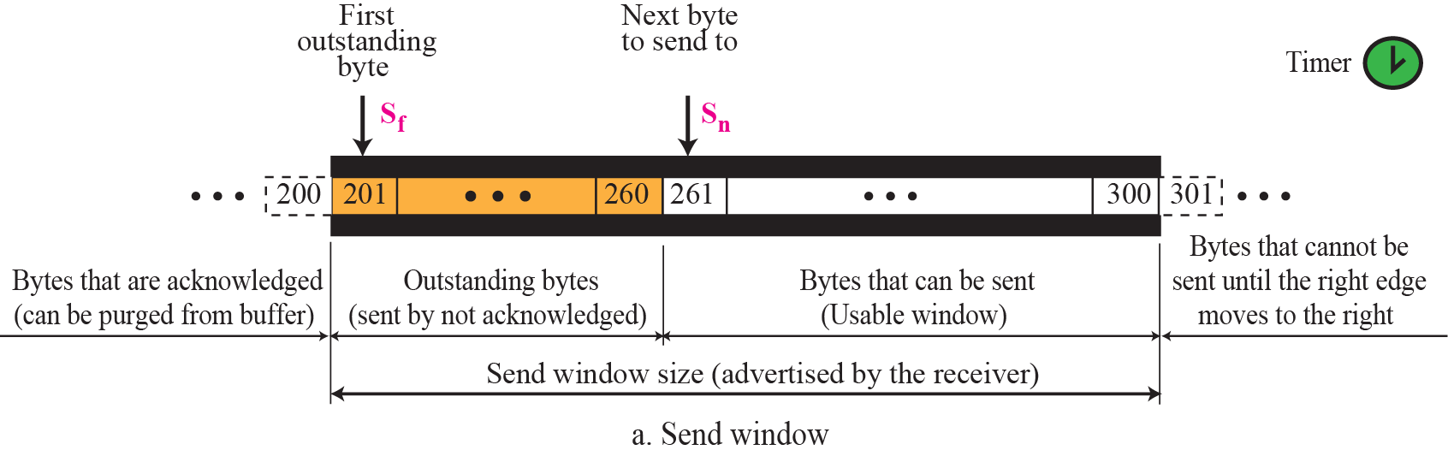
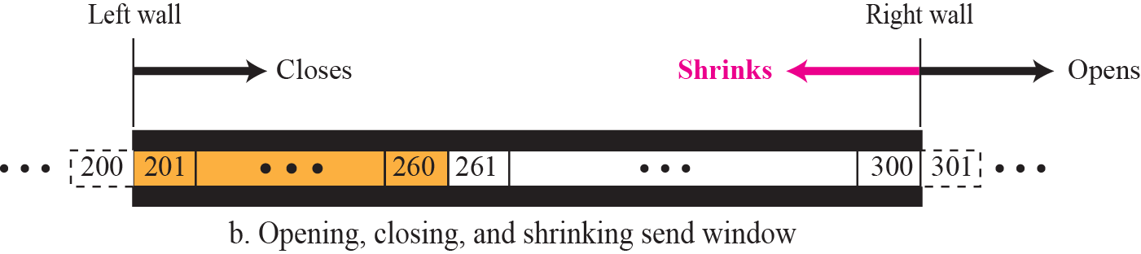
Figure 15.22 Send window in TCP
TCP/IP Protocol Suite
52

Slide 53
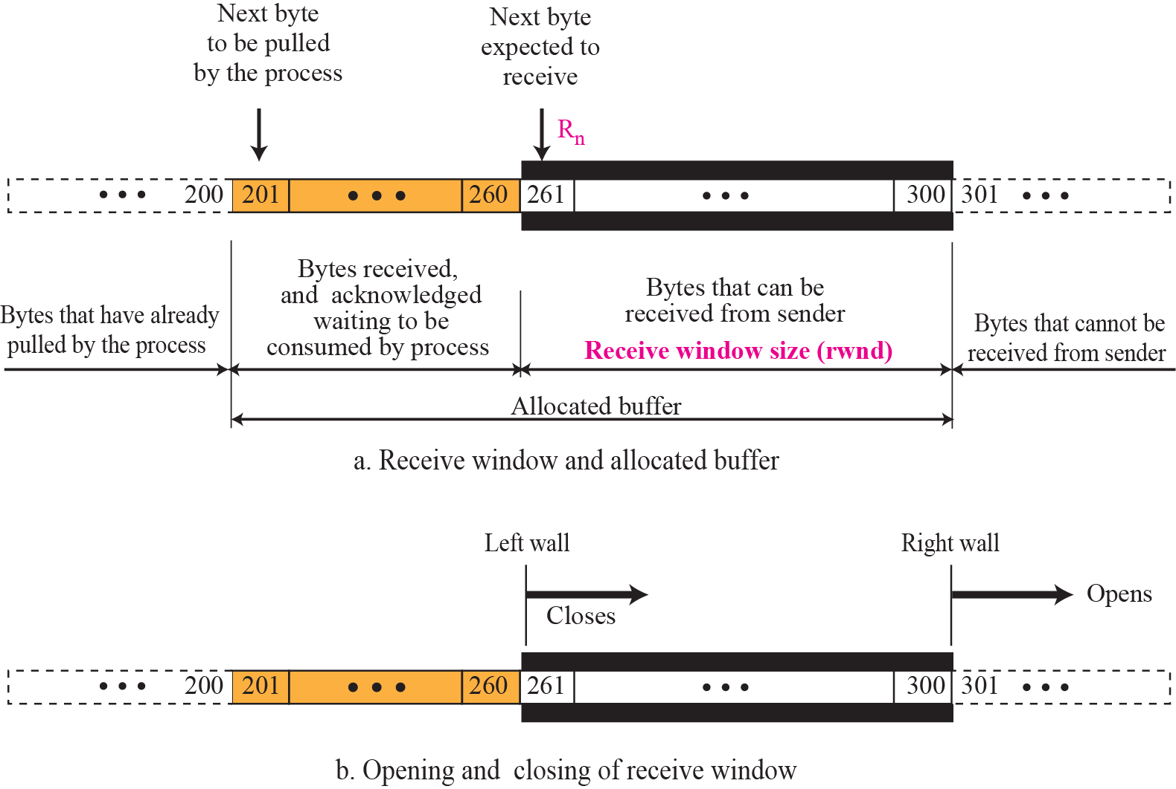
Figure 15.23 Receive window in TCP
TCP/IP Protocol Suite
53

Slide 54
15-7 FLOW CONTROL
As discussed in Chapter 13, flow control balances the rate a producer creates data with the rate a consumer can use the data. TCP separates flow control from error control. In this section we discuss flow control, ignoring error control. We temporarily assume that the logical channel between the sending and receiving TCP is error-free. Figure 15.24 shows unidirectional data transfer between a sender and a receiver; bidirectional data transfer can be deduced from unidirectional one as discussed in Chapter 13.
TCP/IP Protocol Suite
54

Slide 55
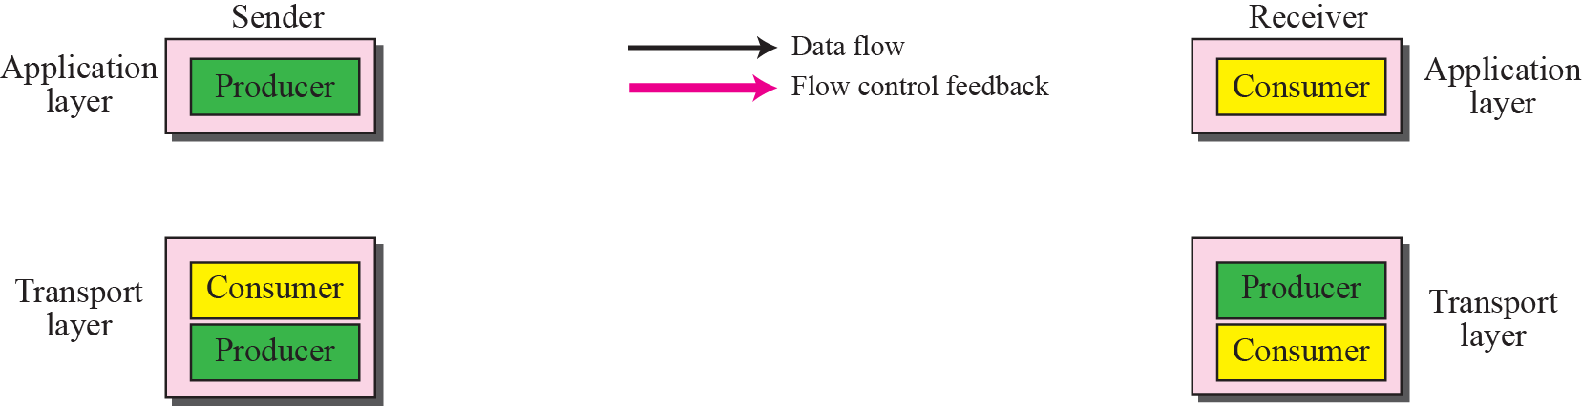
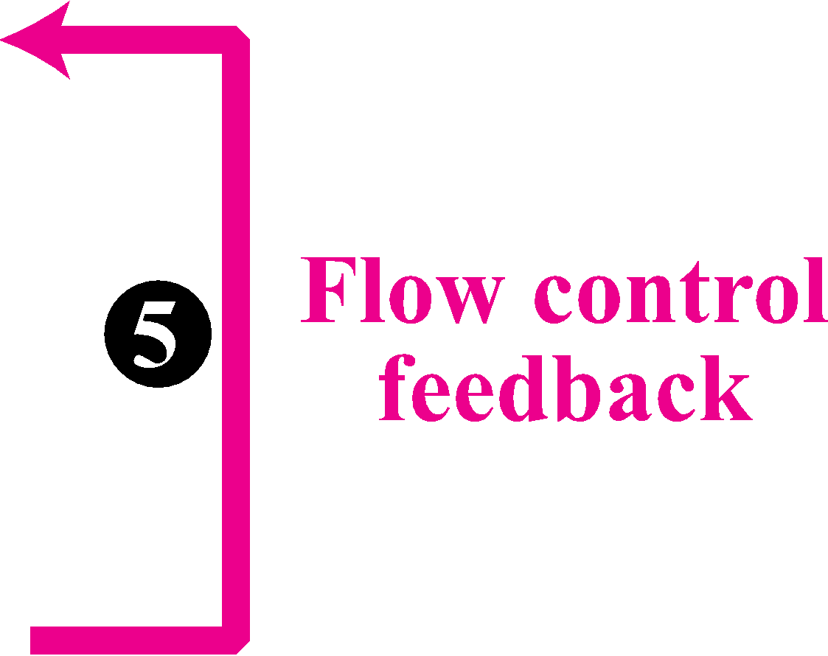
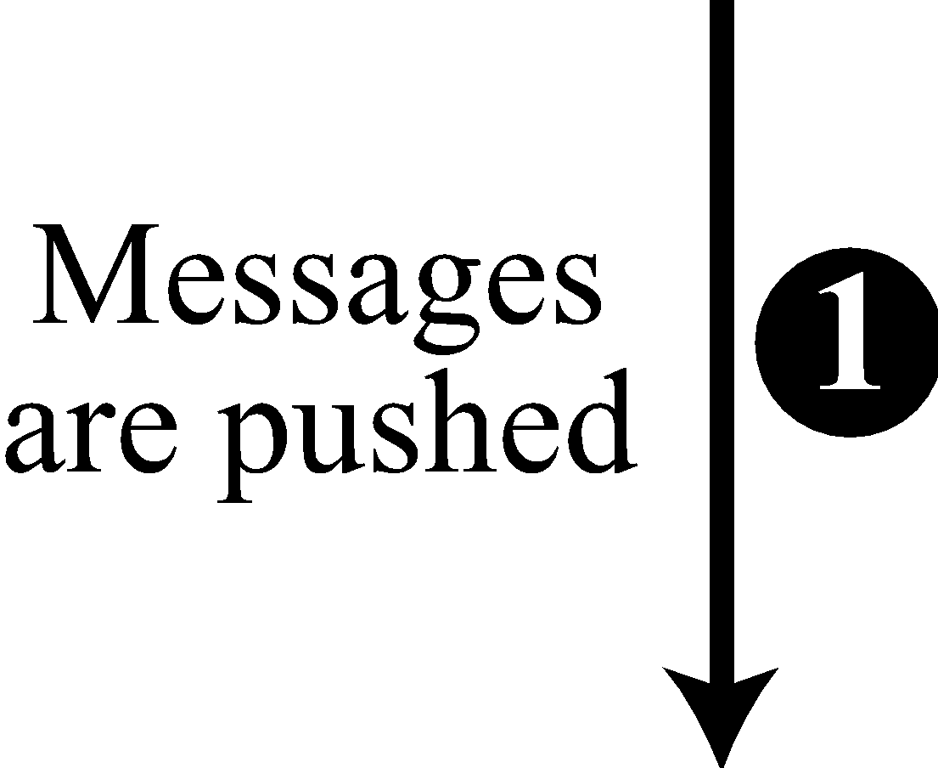
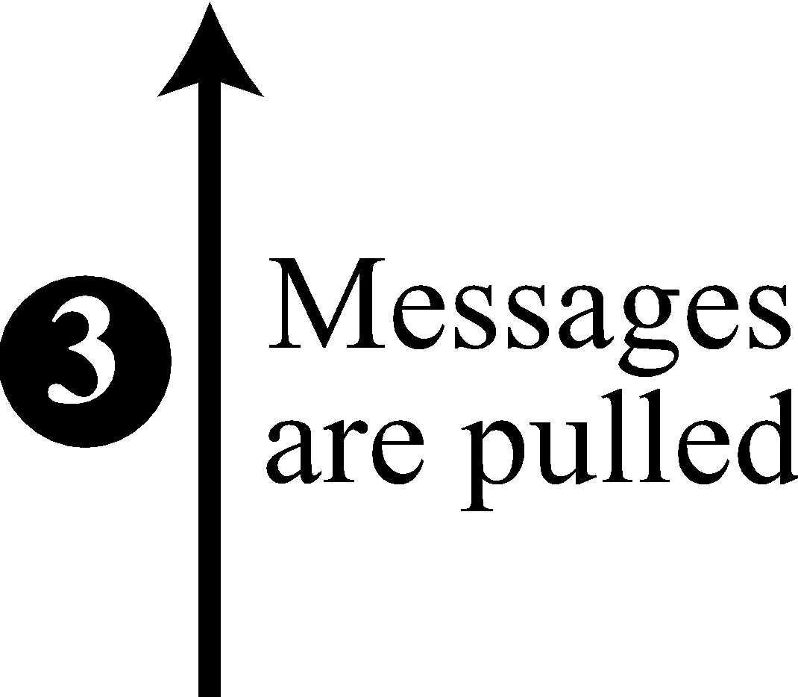

Figure 15.24 TCP/IP protocol suite
TCP/IP Protocol Suite
55

Slide 56
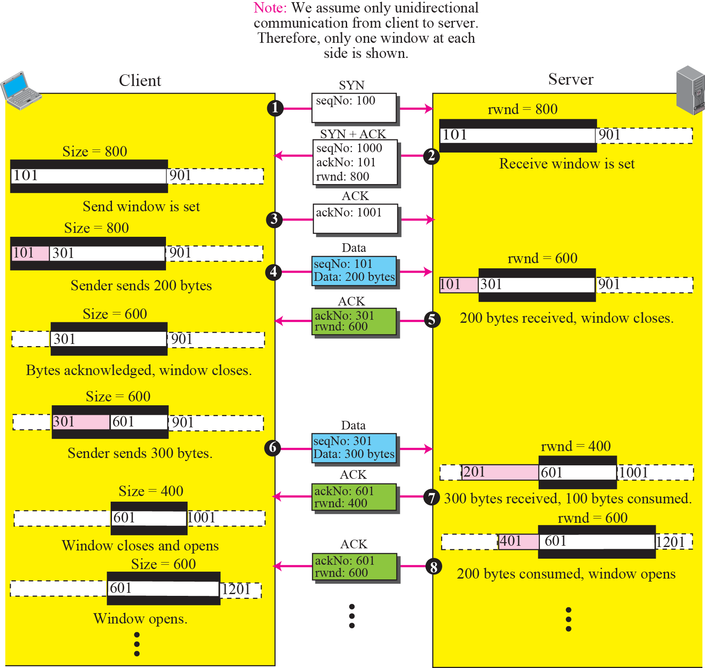
Figure 15.25 An example of flow control
TCP/IP Protocol Suite
56

Slide 57
15-8 ERROR CONTROL
TCP is a reliable transport layer protocol. This means that an application program that delivers a stream of data to TCP relies on TCP to deliver the entire stream to the application program on the other end in order, without error, and without any part lost or duplicated.
Error control in TCP is achieved through the use of three tools: checksum, acknowledgment, and time-out.
TCP/IP Protocol Suite
57

Slide 58
Topics Discussed in the Section
Checksum
Acknowledgment: cumulative, SACK.
Retransmission: RTO, 3 DUPLICATE ACKS.
Out-of-Order Segments:
NORMAL OPERATIONS
LOST SEGMENT
FAST RETRANMISSION
AUTOMATICALLY CORRECTED LOST ACK
LOST ACK CORRECTED BY RESENDING A SEGMENT
TCP/IP Protocol Suite
58

Slide 59
Round Trip Time (RTT) is defined as time between packet send and it's Ack is received . ... Retransmission Time Out (RTO) is the time set for ACK of particular packet to be received , after this time packet is declared as lost and is retransmitted.

Slide 60
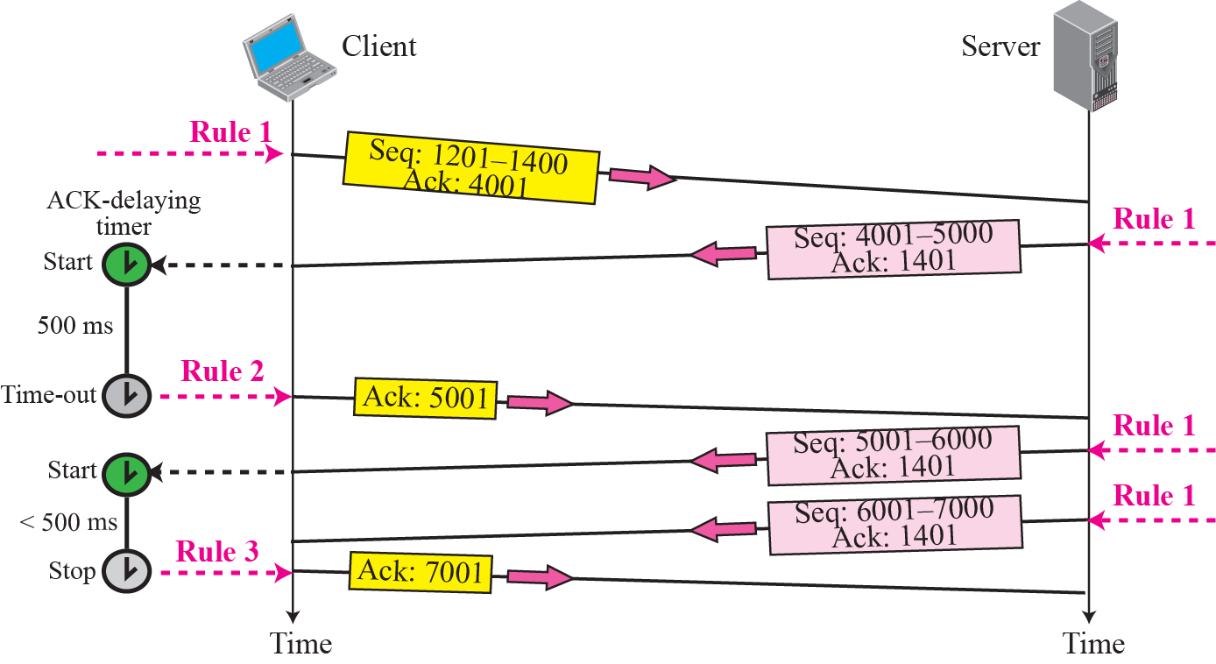
Figure 15.29 Normal operation
TCP/IP Protocol Suite
60

Slide 61
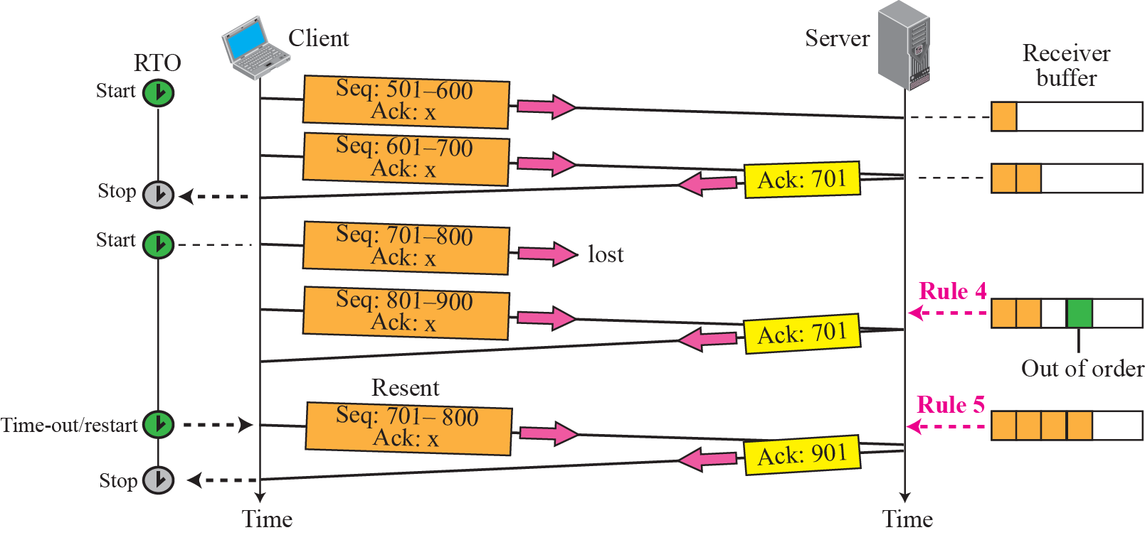
Figure 15.30 Lost segment
TCP/IP Protocol Suite
61

Slide 62
Note
The receiver TCP delivers only ordered data to the process.
TCP/IP Protocol Suite
62

Slide 63
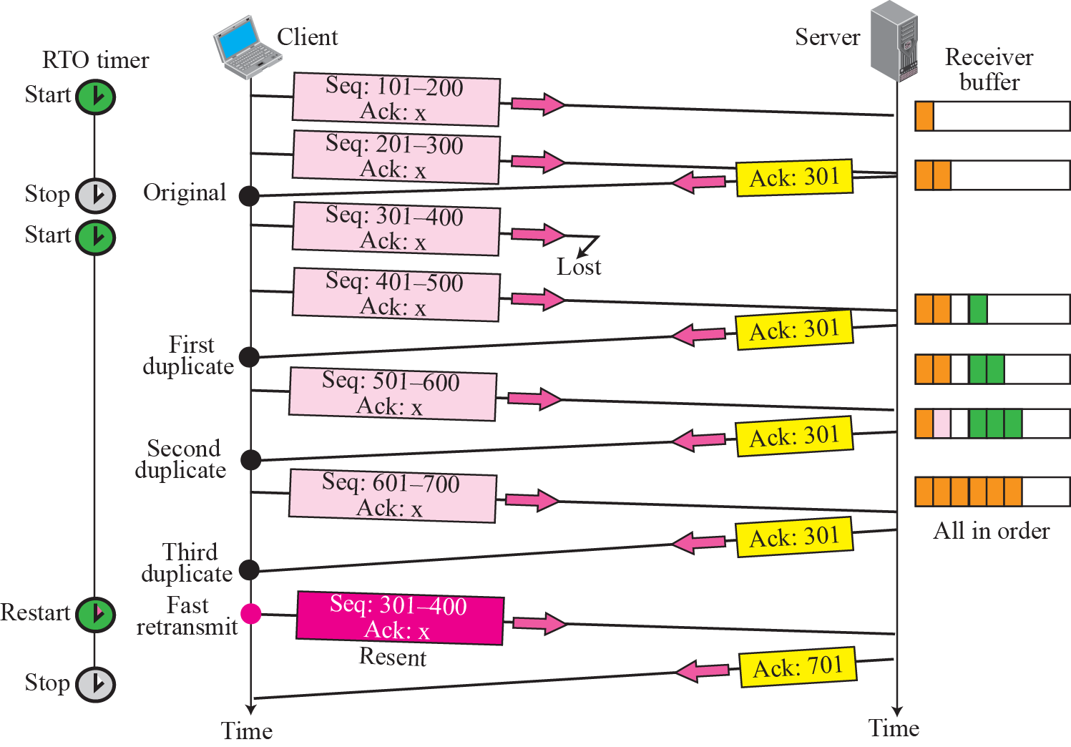
Figure 15.31 Fast retransmission
TCP/IP Protocol Suite
63

Slide 64
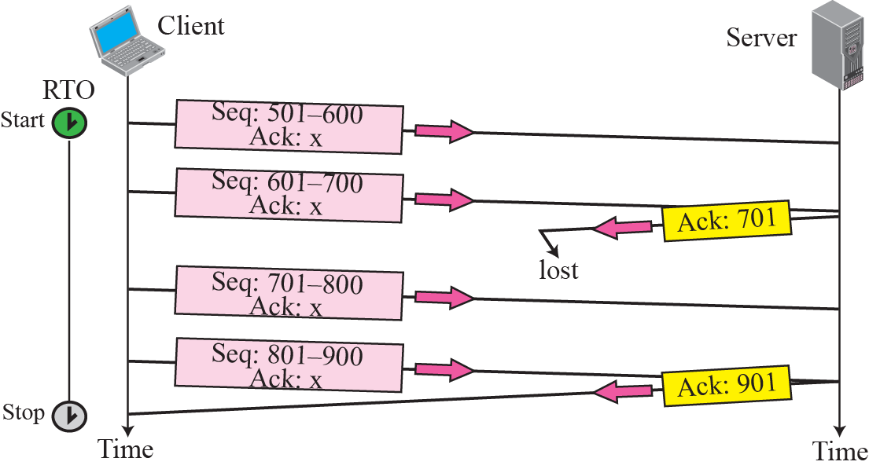
Figure 15.32 Lost acknowledgment
TCP/IP Protocol Suite
64

Slide 65
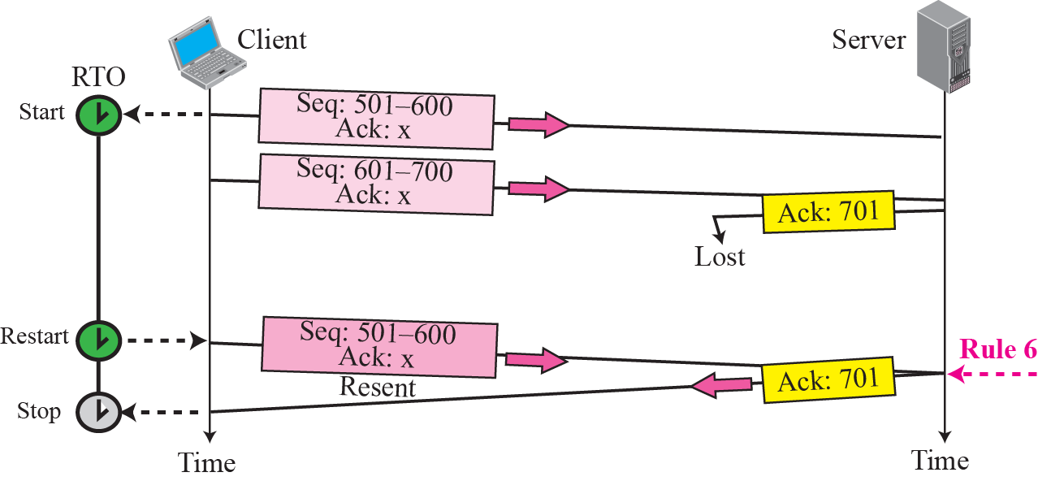
Figure 15.33 Lost acknowledgment corrected by resending a segment
TCP/IP Protocol Suite
65

Slide 66
15-9 CONGESTION CONTROL
Congestion control in TCP uses a congestion window and a congestion policy that avoid congestion and detect and alleviate congestion after it has occurred.
TCP/IP Protocol Suite
66

Slide 67
Topics Discussed in the Section
Congestion Window
Congestion Policy
Congestion Window (cwnd) is a TCP state variable that limits the amount of data the TCP can send into the network before receiving an ACK.
The Receiver Window (rwnd) is a variable that advertises the amount of data that the destination side can receive.
Together, the two variables are used to regulate data flow in TCP connections, minimize congestion, and improve network performance.
TCP/IP Protocol Suite
67

Slide 68
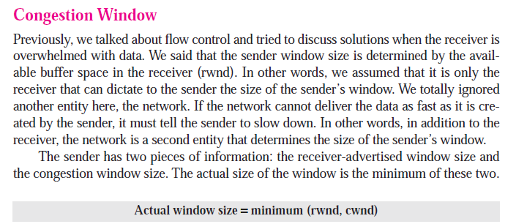
TCP/IP Protocol Suite
68

Slide 69
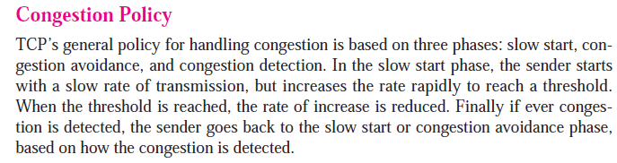
TCP/IP Protocol Suite
69

Slide 70
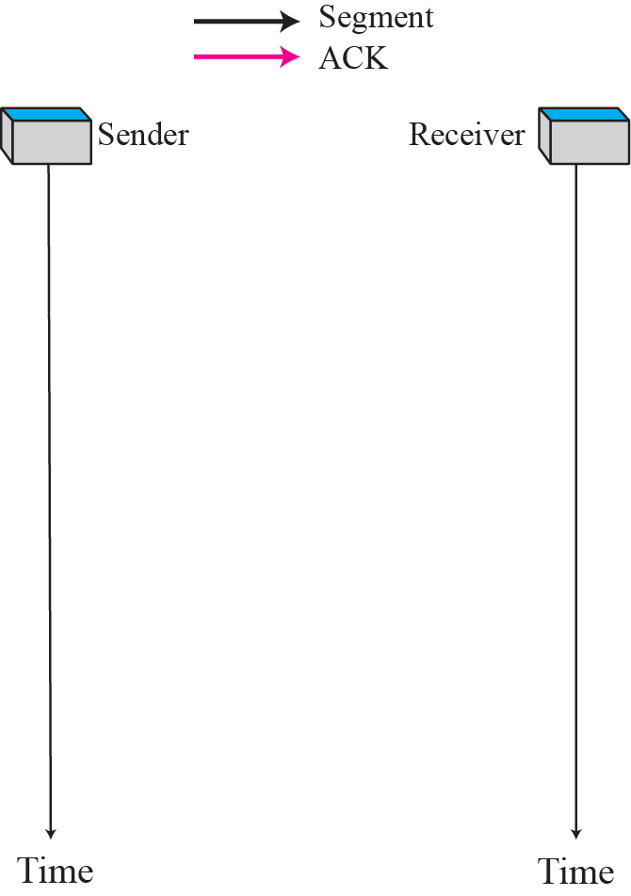
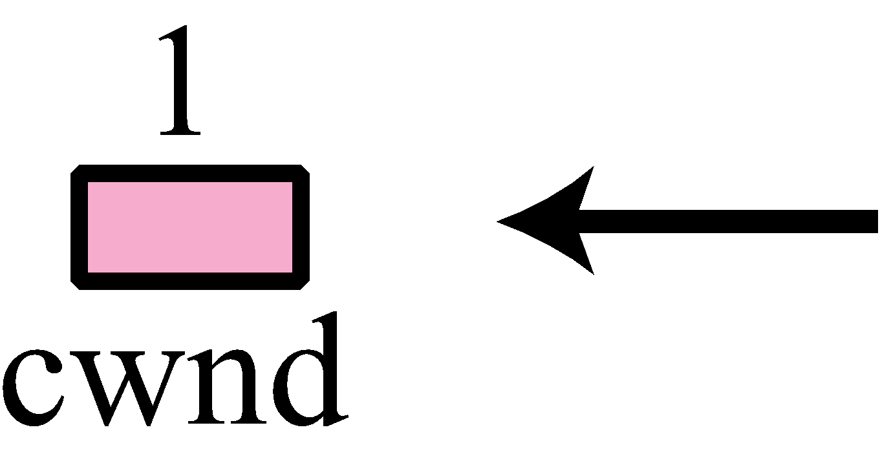
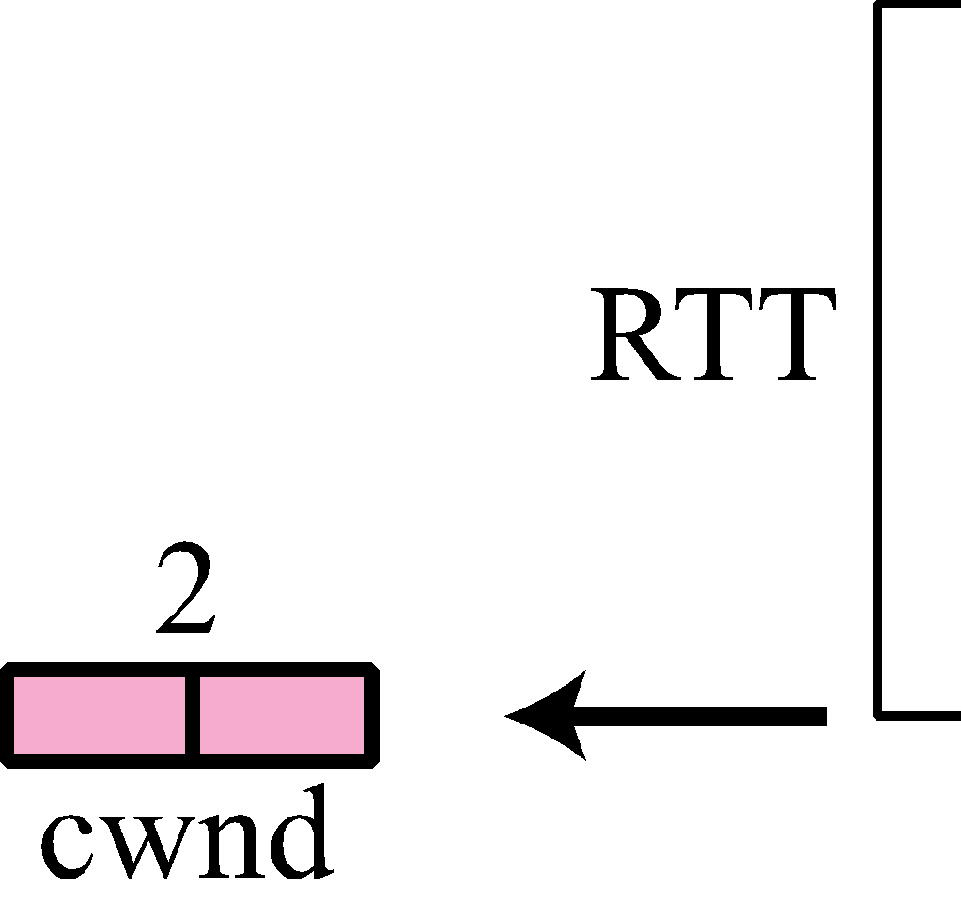








Figure 15.34 Slow start, exponential increase
TCP/IP Protocol Suite
70

Slide 71

TCP/IP Protocol Suite
71

Slide 72
Note
In the slow start algorithm, the size of the congestion window increases exponentially until it reaches a threshold.
TCP/IP Protocol Suite
72

Slide 73

Figure 15.35 Congestion avoidance, additive increase
TCP/IP Protocol Suite
73

Slide 74

TCP/IP Protocol Suite
74

Slide 75
Note
In the congestion avoidance algorithm the size of the congestion window
increases additively until
congestion is detected.
TCP/IP Protocol Suite
75

Slide 76


Slide 77
15-10 TCP TIMERS
To perform its operation smoothly, most TCP implementations use at least four timers .
Timers used by TCP to avoid excessive delays during communication are called as TCP Timers.
TCP/IP Protocol Suite
77

Slide 78
Topics Discussed in the Section
Retransmission Timer
Persistence Timer
Keepalive Timer
TIME-WAIT Timer
TCP/IP Protocol Suite
78

Slide 79

Figure 15.38 TCP timers
TCP/IP Protocol Suite
79

Slide 80
Retransmission Timer
To retransmit lost segments, TCP employs one retransmission timer (for the whole connection period) that handles the retransmission time-out (RTO), the waiting time for an acknowledgment of a segment. We can define the following rules for the retransmission timer:
1. When TCP sends the segment in front of the sending queue, it starts the timer.
2. When the timer expires, TCP resends the first segment in front of the queue, and restarts the timer.
3. When a segment (or segments) are cumulatively acknowledged, the segment (or segments) are purged from the queue.
4. If the queue is empty, TCP stops the timer; otherwise, TCP restarts the timer.
TCP/IP Protocol Suite
80

Slide 81
Sender starts a time out timer after transmitting a TCP segment to the receiver.
If sender receives an acknowledgement before the timer goes off, it stops the timer.
If sender does not receives any acknowledgement and the timer goes off, then TCP Retransmission occurs.
Sender retransmits the same segment and resets the timer.
The value of time out timer is dynamic and changes with the amount of traffic in the network.
Time out timer is also called as Retransmission Timer.

Slide 82
Measured RTT
Smoothed RTT
TCP/IP Protocol Suite
82

Slide 83
Measured RTT(RTTm) – The measured round-trip time for a segment is the time required for the segment to reach the destination and be acknowledged, although the acknowledgment may include other segments.
Smoothed RTT(RTTs) – It is the weighted average of RTTm. RTTm is likely to change and its fluctuation is so high that a single measurement cannot be used to calculate RTO.

Slide 84

TCP/IP Protocol Suite
84

Slide 85

TCP/IP Protocol Suite
85

Slide 86

D
TCP/IP Protocol Suite
86

Slide 87
Note
In TCP, there can be only one RTT measurement in progress at any time.
TCP/IP Protocol Suite
87

Slide 88


Example 15.3
Let us give a hypothetical example. Figure 15.39 shows part of a connection. The figure shows the connection establishment and part of the data transfer phases.
1. When the SYN segment is sent, there is no value for RTTM, RTTS, or RTTD. The value of RTO is set to 6.00 seconds. The following shows the value of these variable at this moment:
2. When the SYN+ACK segment arrives, RTTM is measured and is equal to 1.5 seconds.
TCP/IP Protocol Suite
88

Slide 89

Figure 15.39 Example 15.3
TCP/IP Protocol Suite
89

Slide 90

Example 15.3 Continued
3. When the first data segment is sent, a new RTT measurement starts. No RTT measurement starts for the second data segment because a measurement is already in progress. The arrival of the last ACK segment is used to calculate the next value of RTTM. Although the last ACK segment acknowledges both data segments (cumulative), its arrival finalizes the value of RTTM for the first segment. The values of these variables are now as shown below.
0.75
TCP/IP Protocol Suite
90

Slide 91
Figure 15.39 Example 15.3
TCP/IP Protocol Suite
91

Slide 92


TCP/IP Protocol Suite
92

Slide 93
Example 15.4
Figure 15.40 is a continuation of the previous example. There is retransmission and Karn’s algorithm is applied.
The first segment in the figure is sent, but lost. The RTO timer expires after 4.74 seconds. The segment is retransmitted and the timer is set to 9.48, twice the previous value of RTO. This time an ACK is received before the time-out. We wait until we send a new segment and receive the ACK for it before recalculating the RTO (Karn’s algorithm).
TCP/IP Protocol Suite
93

Slide 94

Figure 15.40 Example 15.4
TCP/IP Protocol Suite
94

Slide 95

TCP/IP Protocol Suite
95

Slide 96


TCP/IP Protocol Suite
96

Slide 97
sender
recvr
Win size=0
Ack=winsize=40
deadlock

Slide 98
sender
recvr
Win size=0
Persistence timer
Ack=winsize=40
deadlock

Slide 99
sender
recvr
Win size=0
Persistence timer starts
Persistence timer stops
probe
Ack for probe
If ack does not come,,,, one more probe will be send and Persistence timer is doubled
probe

Slide 100

TCP/IP Protocol Suite
100

Slide 101
client
server
keepalive timer

Slide 102
https://www.gatevidyalay.com/silly-window-syndrome-nagles-algorithm/

Slide 103
15-11 OPTIONS
The TCP header can have up to 40 bytes of optional information. Options convey additional information to the destination or align other options. We can define two categories of options: 1-byte options and multiple-byte options. The first category contains two types of options: end of option list and no operation. The second category, in most implementations, contains five types of options: maximum segment size, window scale factor, timestamp, SACK-permitted, and SACK (see Figure 15.41).
TCP/IP Protocol Suite
103

Slide 104

Figure 15.41 Options
TCP/IP Protocol Suite
104

Slide 105

TCP/IP Protocol Suite
105

Slide 106

Figure 15.42 End-of-option option
TCP/IP Protocol Suite
106

Slide 107
Note
EOP can be used only once.
TCP/IP Protocol Suite
107

Slide 108


Figure 15.43 No-operation option
TCP/IP Protocol Suite
108

Slide 109
Note
NOP can be used more than once.
TCP/IP Protocol Suite
109

Slide 110

Figure 15.44 Minimum-segment-size option
TCP/IP Protocol Suite
110

Slide 111

Figure 15.45 Window-scale-factor option
TCP/IP Protocol Suite
111

Slide 112

TCP/IP Protocol Suite
112

Slide 113
Note
The value of the window scale factor can be determined only during connection
establishment; it does not change during the connection.
TCP/IP Protocol Suite
113

Slide 114

Figure 15.46 Timestamp option
TCP/IP Protocol Suite
114

Slide 115
Note
One application of the timestamp option is the calculation of round-trip time (RTT).
TCP/IP Protocol Suite
115

Slide 116

TCP/IP Protocol Suite
116

Slide 117

Figure 15.48 SACK
TCP/IP Protocol Suite
117

Slide 118


TCP/IP Protocol Suite
118

Slide 119
Example 15.6
Let us see how the SACK option is used to list out-of-order blocks. In Figure 15.49 an end has received five segments of data.
TCP/IP Protocol Suite
119

Slide 120

Figure 15.49 Example 15.6
TCP/IP Protocol Suite
120

Slide 121
Example 15.7
Figure 15.50 shows how a duplicate segment can be detected with a combination of ACK and SACK. In this case, we have some out-of-order segments (in one block) and one duplicate segment. To show both out-of-order and duplicate data, SACK uses the first block, in this case, to show the duplicate data and other blocks to show out-of-order data. Note that only the first block can be used for duplicate data. The natural question is how the sender, when it receives these ACK and SACK values, knows that the first block is for duplicate data (compare this example with the previous example). The answer is that the bytes in the first block are already acknowledged in the ACK field; therefore, this block must be a duplicate.
TCP/IP Protocol Suite
121

Slide 122

Figure 15.50 Example 15.7
TCP/IP Protocol Suite
122

Slide 123
Example 15.8
Figure 15.51 shows what happens if one of the segments in the out-of-order section is also duplicated. In this example, one of the segments (4001:5000) is duplicated.
The SACK option announces this duplicate data first and then the out-of-order block. This time, however, the duplicated block is not yet acknowledged by ACK, but because it is part of the out-of-order block (4001:5000 is part of 4001:6000), it is understood by the sender that it defines the duplicate data.
TCP/IP Protocol Suite
123

Slide 124

Figure 15.51 Example 15.8
TCP/IP Protocol Suite
124

Slide 125
TCP PACKAGE
TCP/IP Protocol Suite
125

Slide 126
Topics Discussed in the Section
Transmission Control Block TCBs
Timers
Main Module
Input Processing Module
Output Processing Module
TCP/IP Protocol Suite
126

Slide 127

Figure 15.52 TCP PACKAGE
TCP/IP Protocol Suite
127

Slide 128

TCP/IP Protocol Suite
128

Slide 129

TCP/IP Protocol Suite
129

Slide 130

established
TCP/IP Protocol Suite
130

Slide 131

TCP/IP Protocol Suite
131

Slide 132


TCP/IP Protocol Suite
132

Slide 133


TCP/IP Protocol Suite
133

Slide 134


TCP/IP Protocol Suite
134

Slide 135

TCP/IP Protocol Suite
135

Slide 136

TCP/IP Protocol Suite
136

Slide 137


TCP/IP Protocol Suite
137

Slide 138

TCP/IP Protocol Suite
138

Slide 139


TCP/IP Protocol Suite
139

Slide 140

TCP/IP Protocol Suite
140

